Slide 1
松弛-修正算法
熊浚丞

Slide 2
目录
支持向量机(SVM)
广义分配问题(GAP)

Slide 3
支持向量机

Slide 4
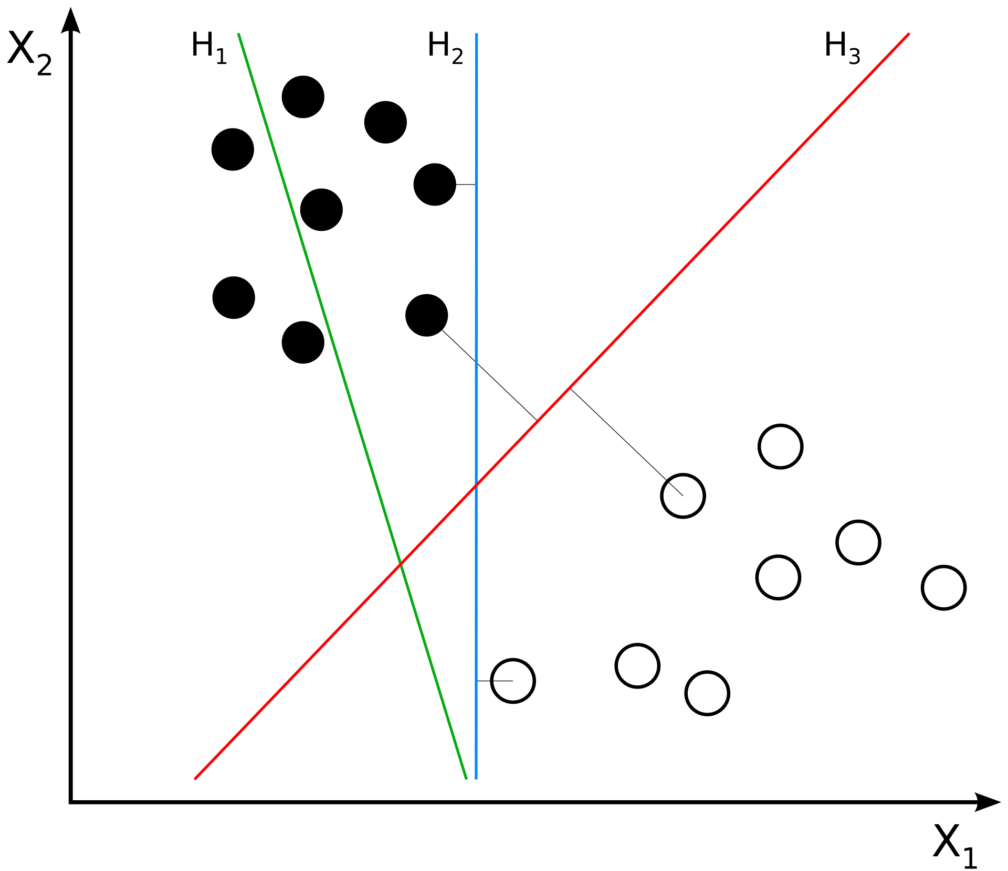
Support Vector Machine
支持向量机是一种古老的AI算法，它应用于数据的二分类。
简单来说：
平面上的若干点分为两类，我们要用一条直线分隔这些点（假设这是能做到的），并保证距离该直线最近的点距离直线最远。
扩展的描述：
n维空间中有若干点分为两类，我们要用一个n-1维的超平面分隔这些点（假设这是能做到的），并保证距离该超平面最近的点距离超平面最远。

Slide 5

Basic Knowledge
Calculating distance
The distance of a point x to a hyperplane $w^{T}⋅x+b=0$ is $\frac{|w^{T}⋅x+b|}{\left\|w\right\|}$，where $\left\|w\right\|=\sqrt{w_{1}^{2}+w_{2}^{2}+…+w_{n}^{2}}$

Slide 6
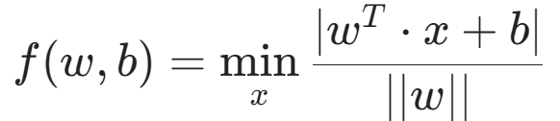





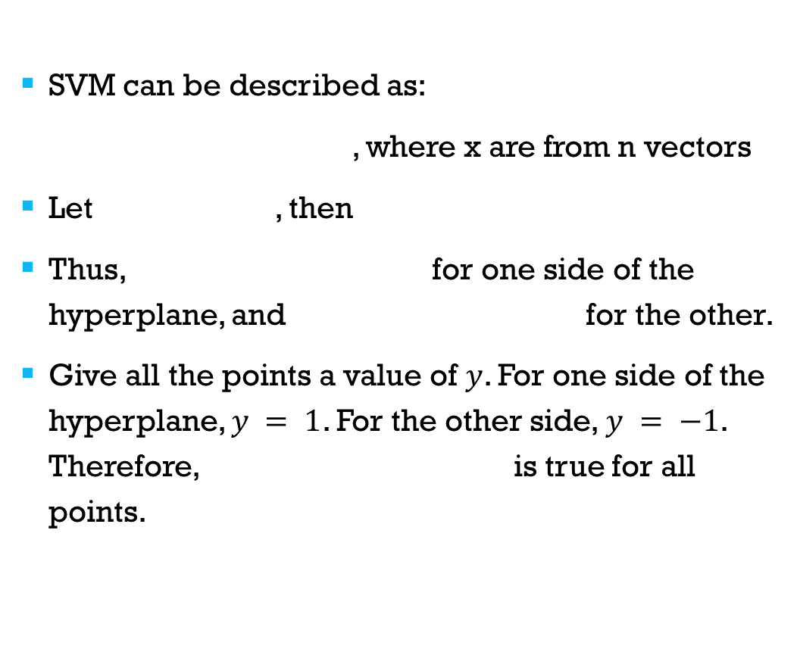
Problem Definition
SVM can be described as:
, where x are from n vectors
Let , then
Thus, for one side of the hyperplane, and for the other.
Give all the points a value of $y$. For one side of the hyperplane, $y = 1$. For the other side, $y = −1$. Therefore, is true for all points.

Slide 7


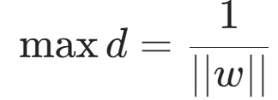
, and then?
Note that the equation for hyperplanes can multiply a factor. In order to make one hyperplane correspond to only one such equation, we suppose that holds for every hyperplane. Thus, we have
Now, our problem becomes:
s.t.

Slide 8
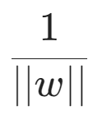

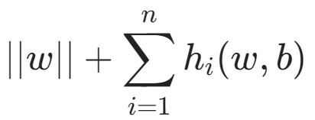
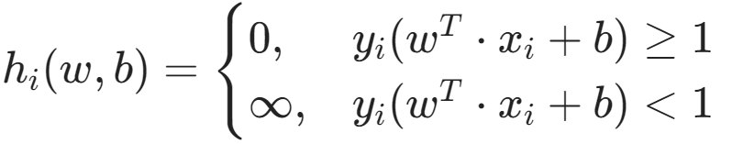
Into unconstrained optimization
To maximize equals to minimize .
We can convert the constrained optimization into unconstrained optimization by solving the minimum of :
Where
This is another way of “constrain”

Slide 9



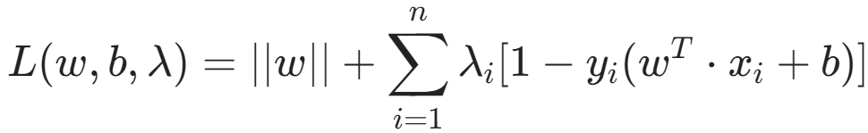

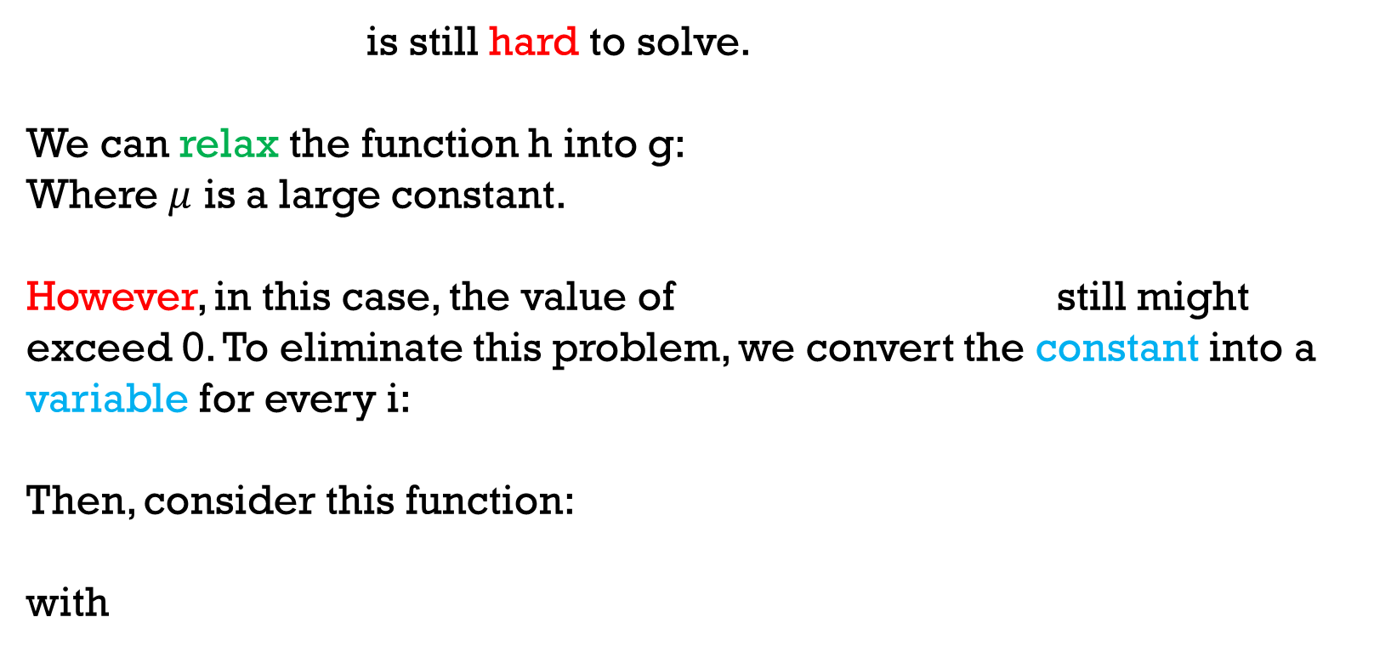
Give it a relaxation
is still hard to solve.
We can relax the function h into g:
Where $μ$ is a large constant.
However, in this case, the value of still might exceed 0. To eliminate this problem, we convert the constant into a variable for every i:
Then, consider this function:
with

Slide 10

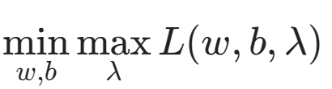


Give it a relaxation
For , we want that
is guaranteed, so we can simply solve . Here, when the constrains are not met, can be very huge, and we can’t get the minimum of .

Slide 11
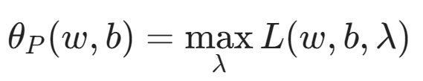
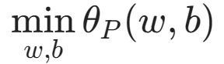


Give it a relaxation
Let , so the original problem is converted into
without any constrains.
Also let , another problem is to solve .
These two are called dual problems. P means primary and D means dual.

Slide 12






Weak Dual Theorem:
where with different min/max variables.
Prove:
holds for all its variables. also holds for all its variables.
Thus
For our SVM problem, instead of solving , we can solve the dual problem to relax.

Slide 13
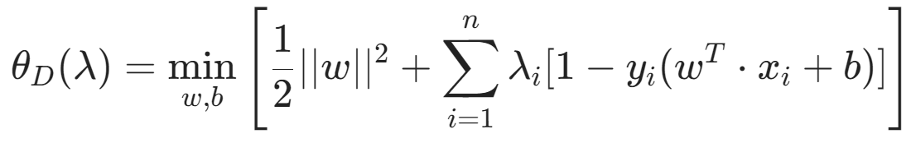

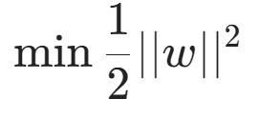
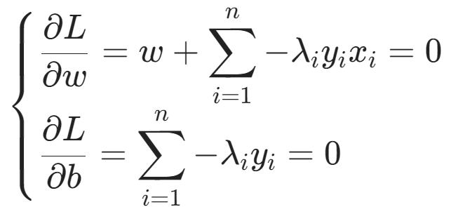
Now, we have to solve
Note that to get we can just solve .
Taking partial derivatives, we get

Slide 14
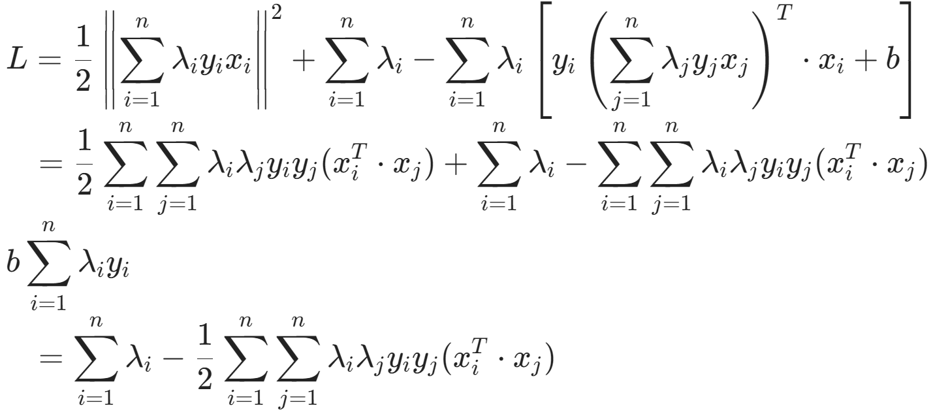
Substituting back into the original equation, we obtain

Slide 15
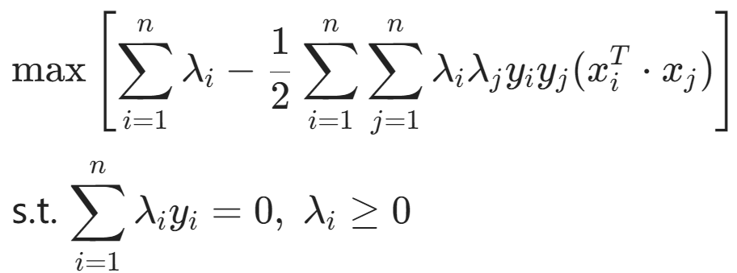
Finally…
The problem is to solve:
This is a quadratic programming problem and can be solved with SMO algorithm.

Slide 16
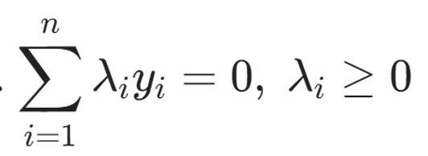

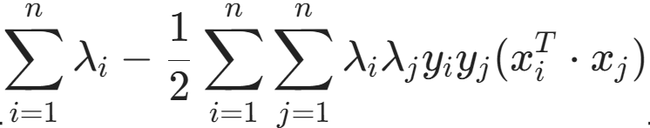
Real Final: SMO
SMO: Sequential Minimal Optimization
There are many variables , we can’t solve them at once. The method of SMO is to fix all other variables and adjust one variable . However, we have the constrain , so we only fix n-2 other variables.
The constrain becomes . Substituting this into
and take partial derivative we can
get a larger value.
Recursively doing this we can get the optimal solution.

Slide 17
How to get the original problem’s answer?
Fortunately, for SVM problem, it satisfies strong duality. Strong duality implies that both the primal and dual problems have solutions, and their optimal solutions are equal.

Slide 18
广义分配问题

Slide 19
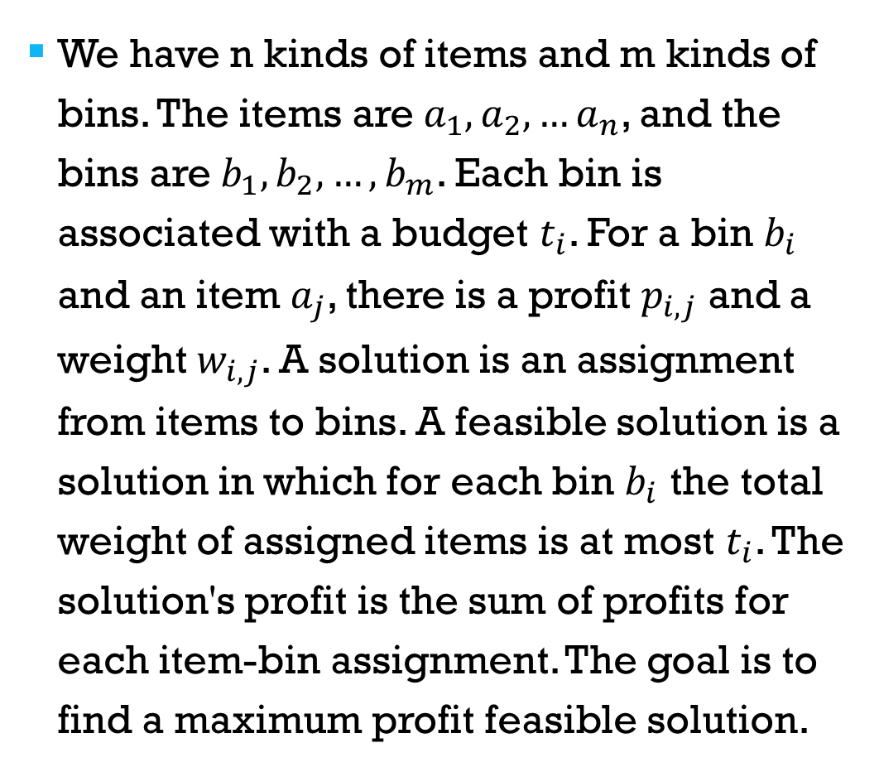
Problem Definition
We have n kinds of items and m kinds of bins. The items are $a_{1},a_{2},…a_{n}$, and the bins are $b_{1},b_{2},…,b_{m}$. Each bin is associated with a budget $t_{i}$. For a bin $b_{i}$ and an item $a_{j}$, there is a profit $p_{i,j}$ and a weight $w_{i,j}$. A solution is an assignment from items to bins. A feasible solution is a solution in which for each bin $b_{i}$ the total weight of assigned items is at most $t_{i}$. The solution's profit is the sum of profits for each item-bin assignment. The goal is to find a maximum profit feasible solution.

Slide 20
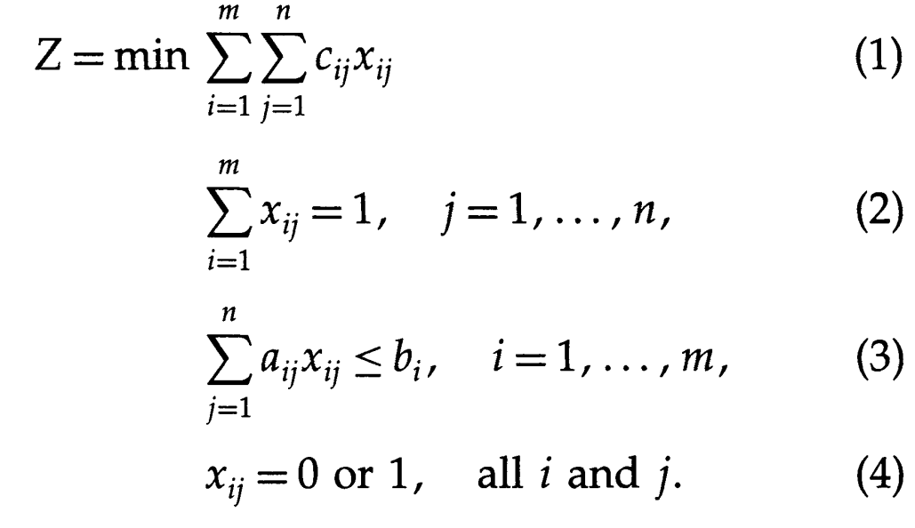
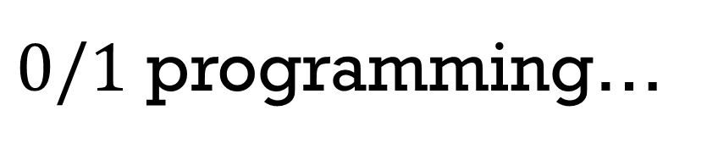
$0/1$ programming…

Slide 21
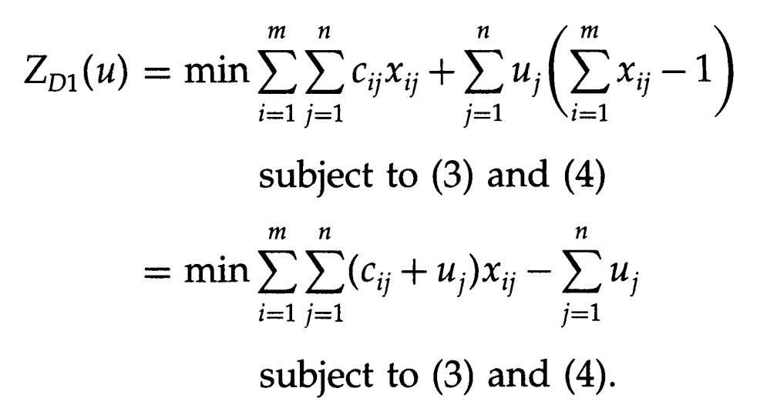
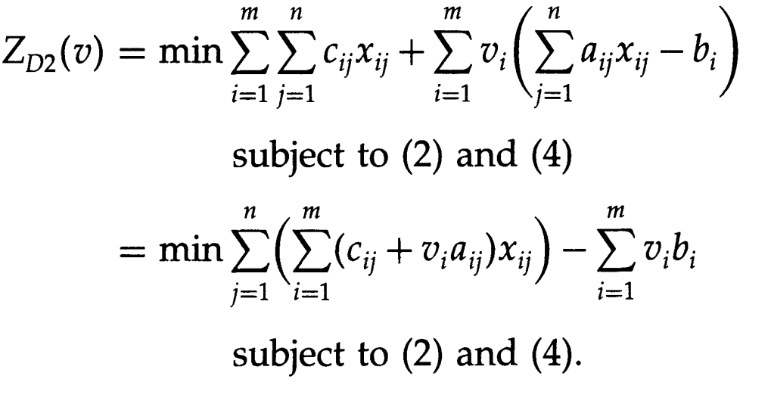
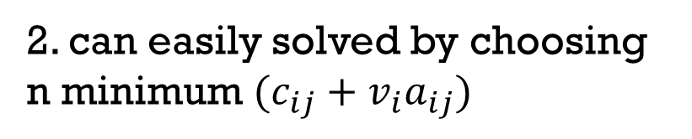
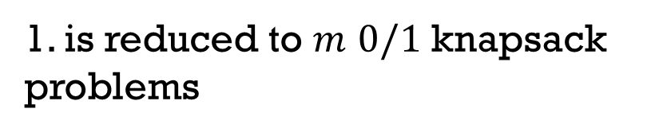
Two ways of relaxation
1.
1. is reduced to $m$ $0/1$ knapsack problems
2.
2. can easily solved by choosing n minimum $(c_{ij}+v_{i}a_{ij})$

Slide 22
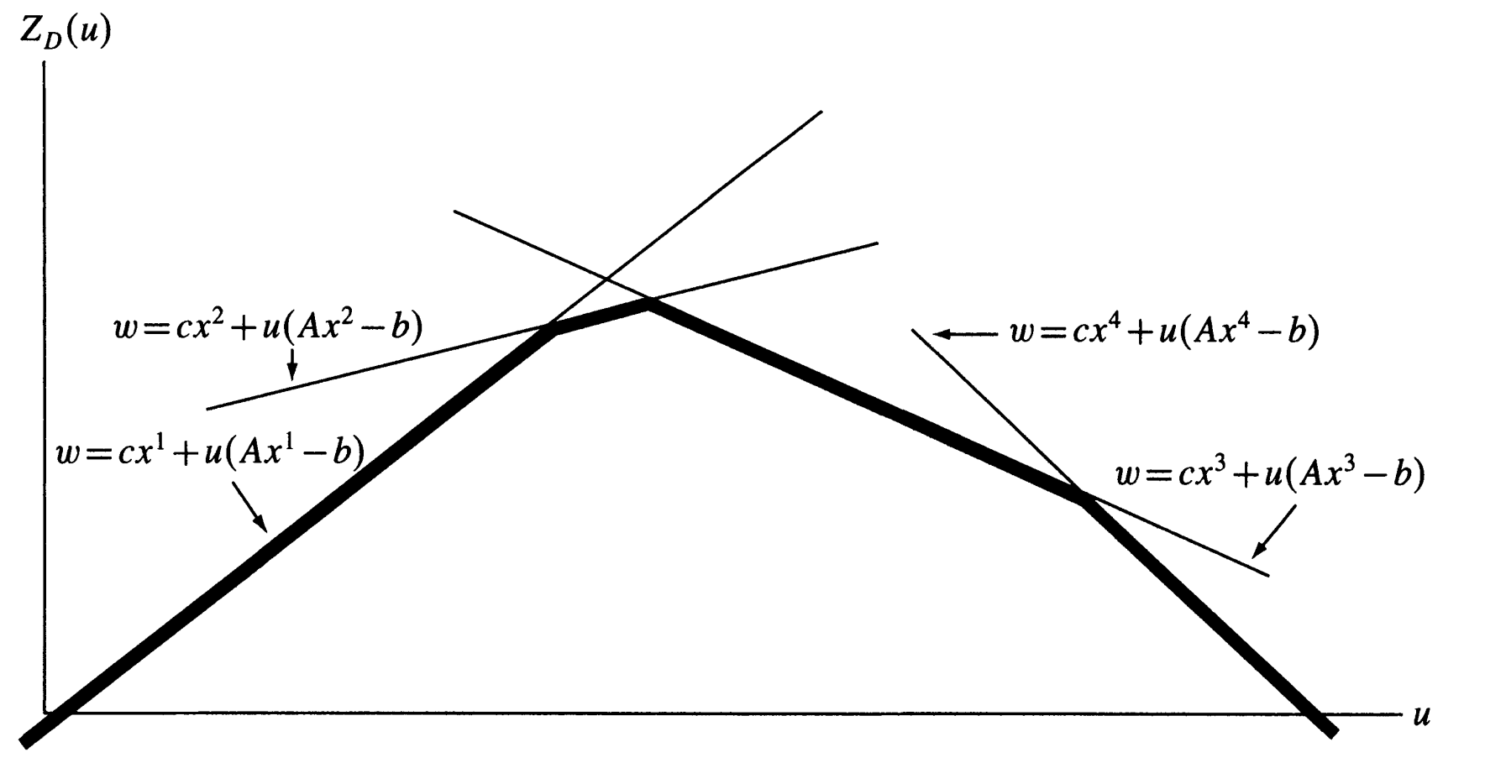

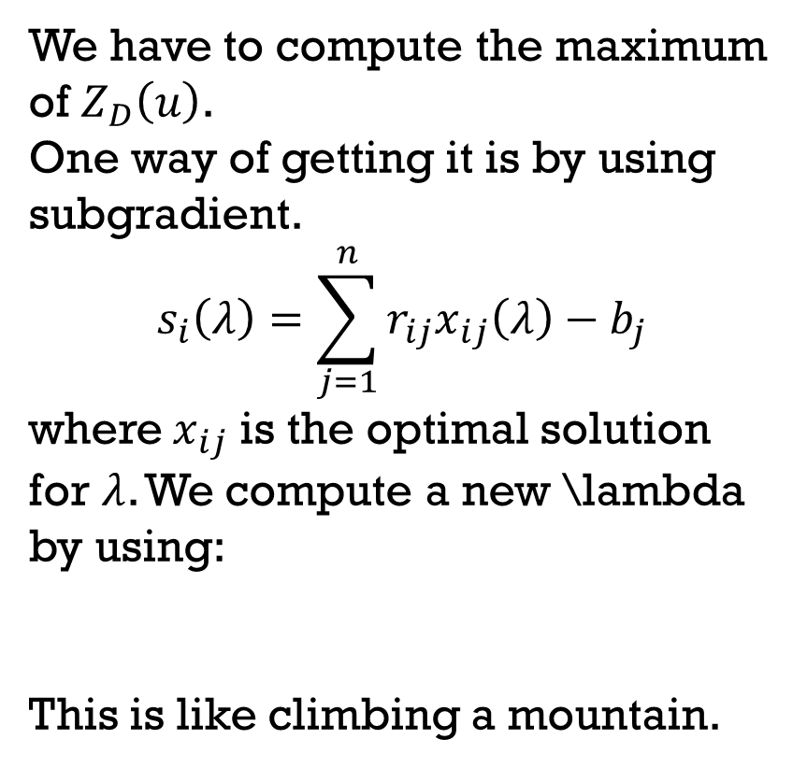
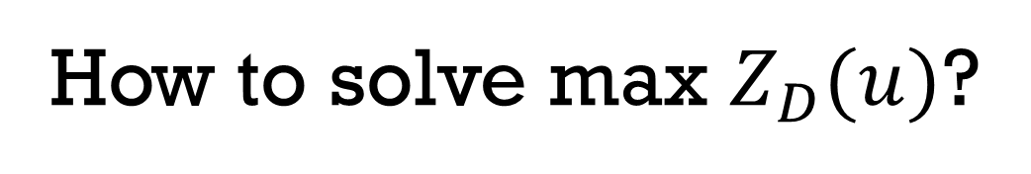
How to solve max $Z_{D}(u)$?
We have to compute the maximum of $Z_{D}\left(u\right)$.
One way of getting it is by using subgradient.
$$s_{i}\left(λ\right)=\sum_{j=1}^{n}{r_{ij}x_{ij}\left(λ\right)−b_{j}}$$
where $x_{ij}$ is the optimal solution for $λ$. We compute a new \lambda by using:
This is like climbing a mountain.

Slide 23
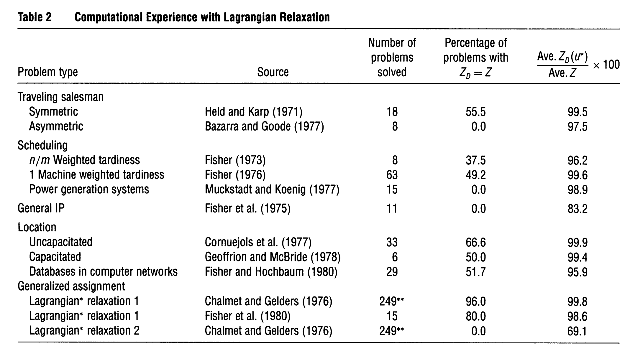
Round Compare
It is shown that the first way of relaxation is better:

Slide 24
References
The Lagrangian Relaxation Method for Solving Integer Programming Problems
https://en.wikipedia.org/wiki/Support_vector_machine

